Slide 1
A Ensemble Model for Diabetes Prediction
Taslim Ahamd [24MCA1026]
Guided by: Dr. Manjula V

Slide 2

Guide’s Approval

Slide 3
Project Overview
Project Title:
A Ensemble Model for Diabetes Prediction
Objective:
To build an accurate diabetes prediction system using a stacking ensemble of machine learning . models, including a Graph Convolutional Network (GCN)
Dataset Summary:
768 medical records with 18 features (original + engineered)
Includes health metrics like Glucose, BMI, Insulin, Age
Binary classification: Diabetic or Non-Diabetic
Highly imbalanced with more non-diabetic cases
GCN uses graph-based patient similarity through edge_index
Key Steps Undertaken:
Exploratory Data Analysis: Analyzed feature impact, removed zero entries
Preprocessing: Scaled data, handled missing values, encoded features
Feature Engineering: Added obesity, glucose level, insulin score labels
Modeling: Trained 8 base models including GCN and tree-based models
Evaluation: Compared models using Accuracy, Recall, F1-Score, Confusion Matrix
Final Outcome:
An effective ensemble-based approach for diabetes prediction using advanced preprocessing, . engineered features, and graph-enhanced learning.
.

Slide 4
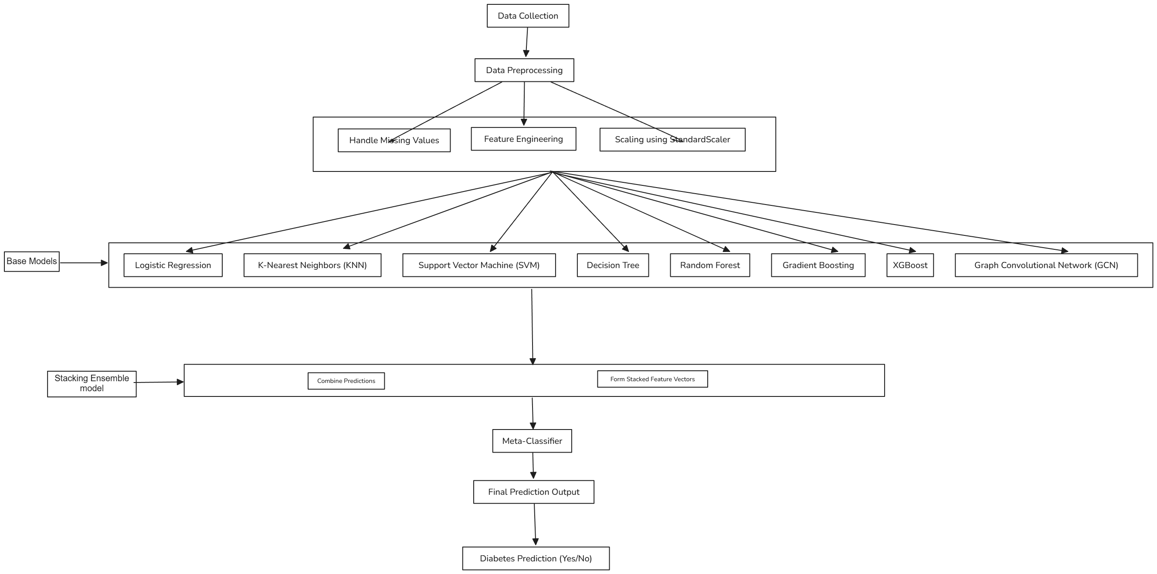
System Architecture

Slide 5
System Architecture Continue
1. Data Preprocessing
Before training any model, raw data is cleaned and transformed. This includes:
Handling Missing Values: Missing entries are either imputed (e.g., using mean/median) or removed.
Feature Engineering: New features are created or existing ones are transformed to enhance the predictive power.
Feature Scaling: Standardization (using StandardScaler) ensures that all features are on the same scale, which is crucial for distance-based models like KNN and gradient-based optimizers.
2. Base Models
A diverse set of machine learning algorithms are used as base learners. Each of them captures different patterns in the data:
Logistic Regression – a linear model suitable for binary classification.
K-Nearest Neighbors (KNN) – a non-parametric model based on similarity between data points.
Support Vector Machine (SVM) – constructs hyperplanes for separating classes.
Decision Tree – learns decision rules from the data features.
Gradient Boosting (XGBoost) – an ensemble method that builds trees sequentially to reduce error.
Each base model is trained independently on the same preprocessed data.
3. Stacking Ensemble Model
In stacking:
The predictions from base models are collected.
These predictions are used to form stacked feature vectors.
A meta-classifier (usually a Logistic Regression or another robust model) is trained on these new vectors.
This second-level model learns how to best combine the outputs of the base learners to improve overall performance

Slide 6
Modules
Preprocessing
Feature Engineering
Cleans and prepares raw data for analysis.
Detects and handles null or zero values in critical medical fields (like Glucose, Blood Pressure, Skin Thickness, Insulin, and BMI).
Replaces these values with the median of the respective column to retain data distribution.
Applies RobustScaler for normalization, which is robust to outliers—ensuring balanced feature , ranges.
Creates additional, meaningful features to enhance model input.
Derives BMI categories: Underweight, Normal, Overweight, Obesity Levels 1–3.
Generates Insulin Score groups: Normal and Abnormal insulin response levels.
Constructs Glucose Level indicators: Low, Normal, Overweight, Secret (extreme high levels).
Adds domain-driven transformations to capture hidden patterns in the data.

Slide 7
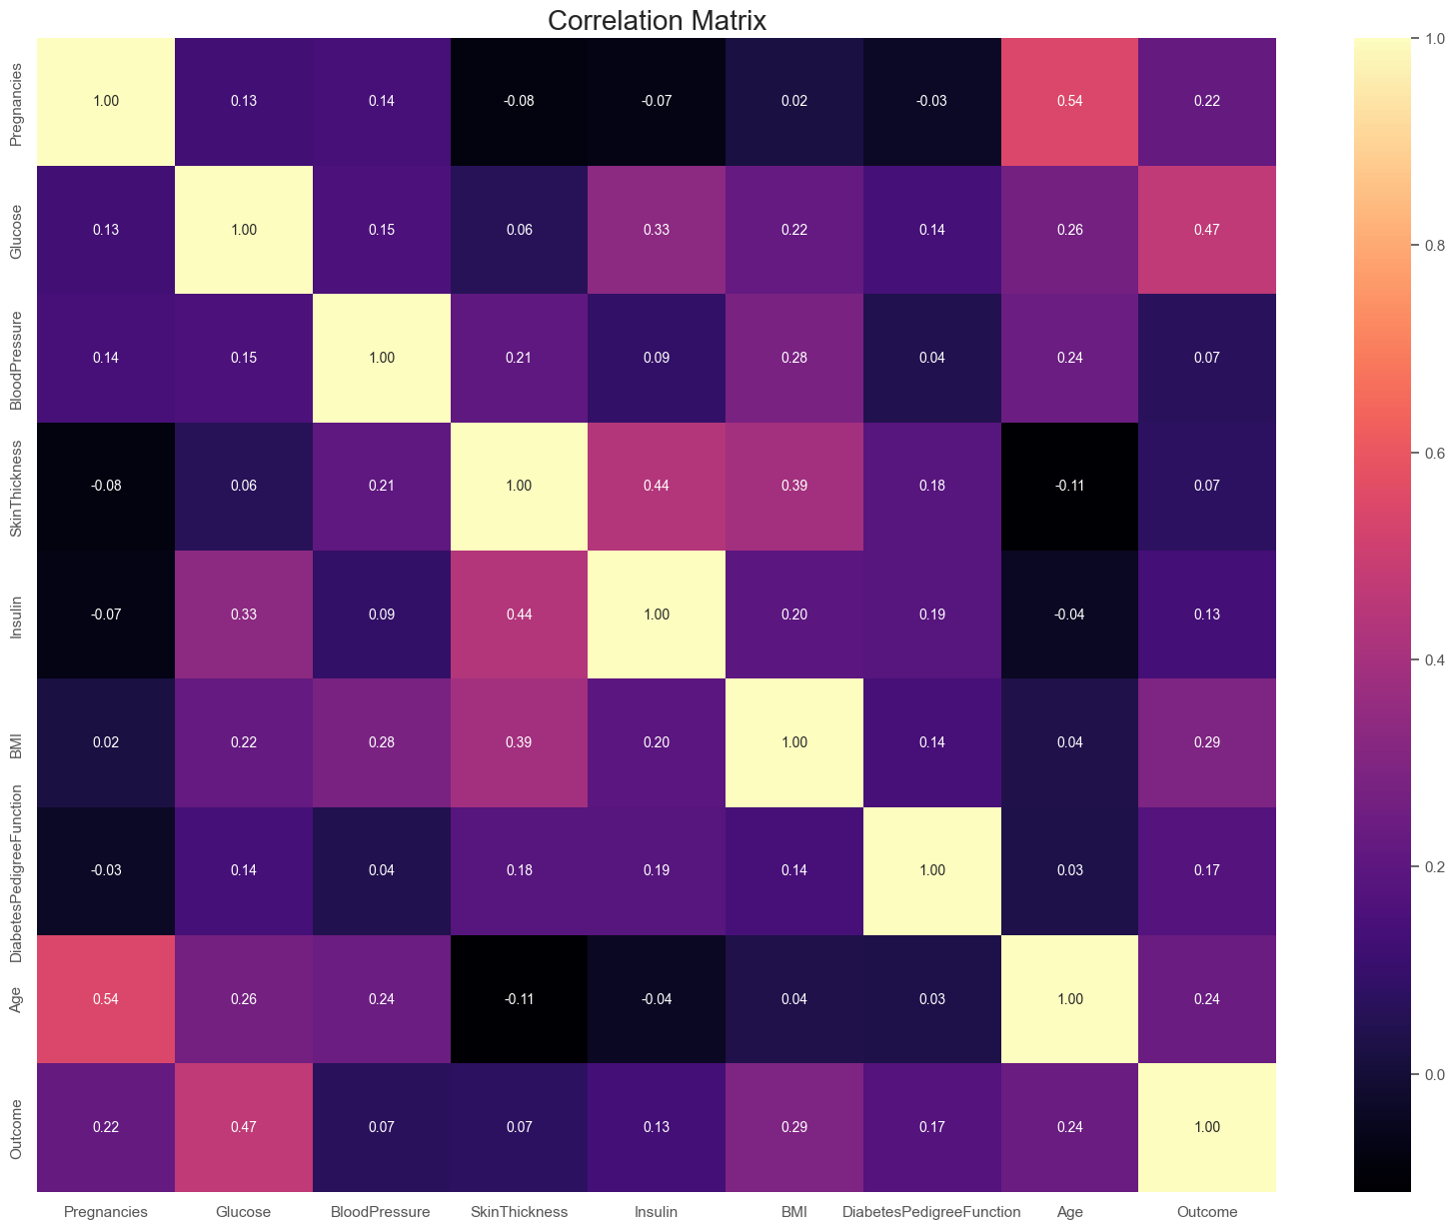
Correlation Matrix

Slide 8
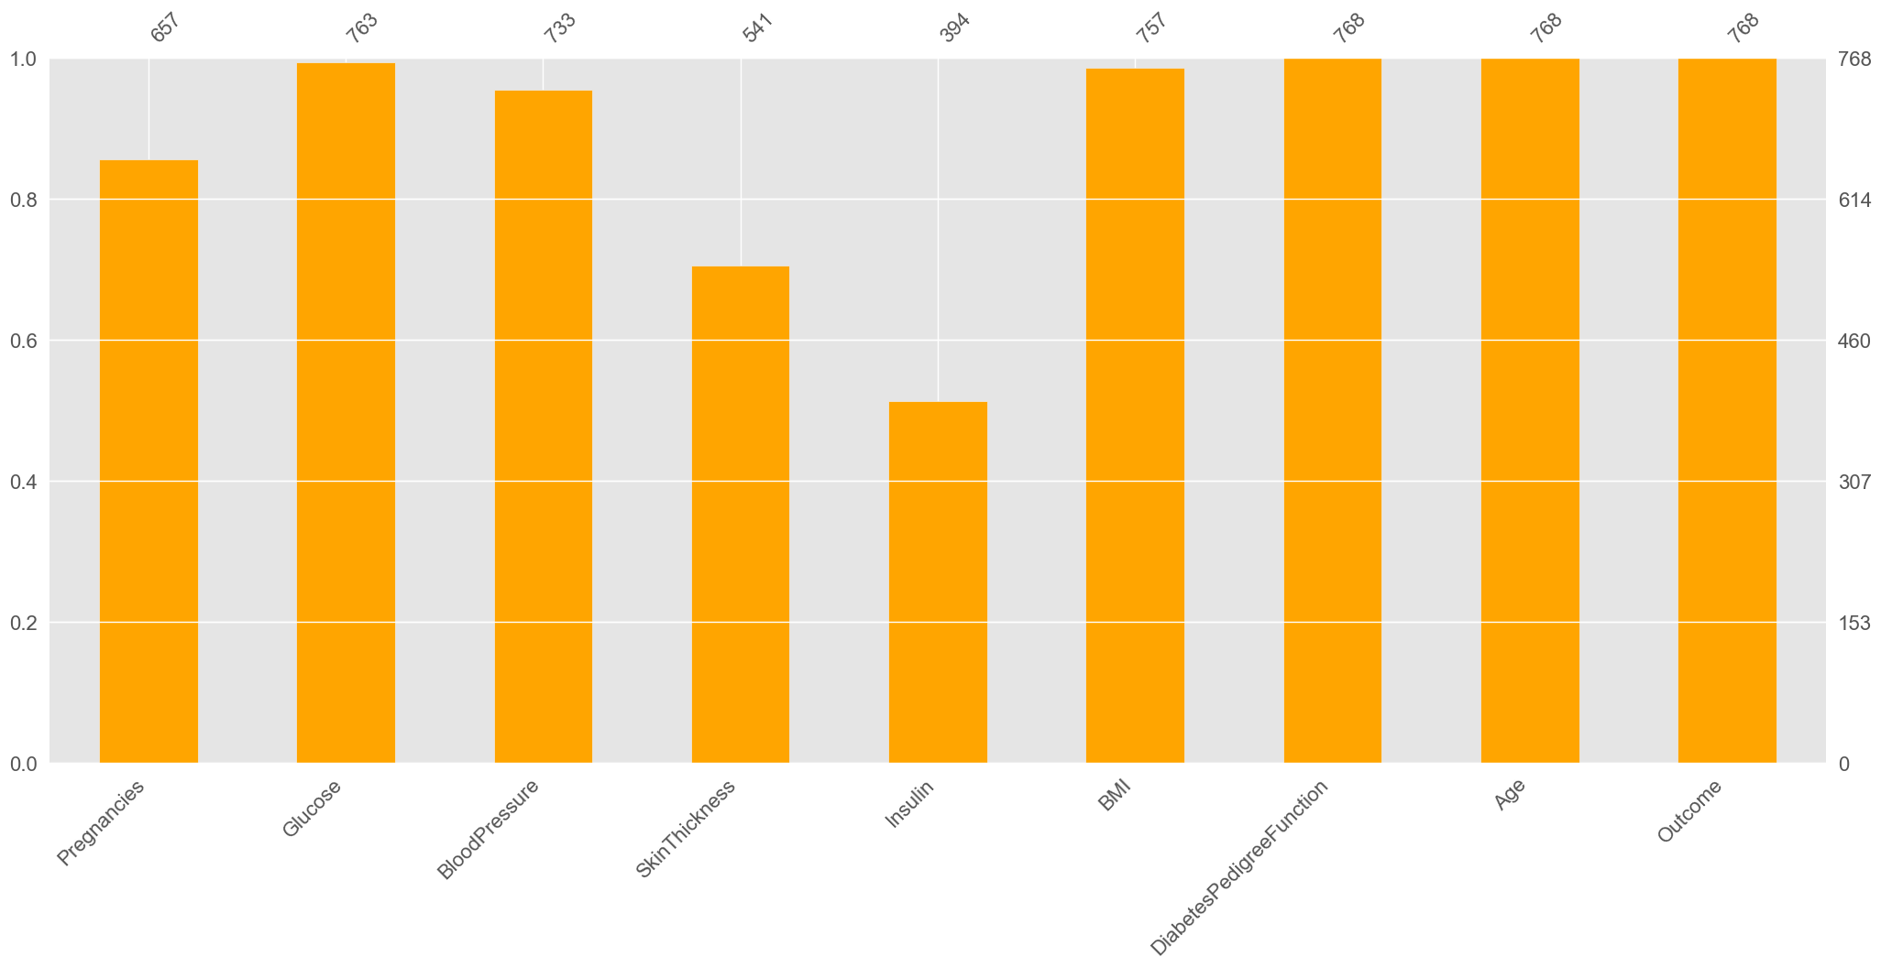
Bar plot showing missing data per feature. Columns like Insulin and SkinThickness have many missing values. Orange bars represent non-null entries.

Slide 9
Algorithm Used
Logistic Regression
K-Nearest Neighbors (KNN)
Why: Ideal for binary classification like predicting diabetes (Yes/No); offers interpretable results to understand the influence of each feature.
How: Uses sigmoid function to convert input values into probability scores between 0 and 1.
Why: Suitable for diabetes data where similar patients tend to have similar outcomes does not assume any data distribution.
How: Classifies based on majority vote from the K closest data points (neighbors)
Support Vector Machine (SVM)
Why: Effective for complex diabetes datasets with high dimensionality and clear decision boundaries.
How: Finds the optimal hyperplane that separates diabetic and non-diabetic classes with the maximum .margin.
Decision Treeupport Vector Machine (SVM)
Why: Provides easy-to-understand decision rules for diabetes prediction; handles both categorical and numerical features.
How: Builds multiple trees on random subsets and averages their predictions.)

Slide 10
Algorithm Used
Random Forest
Gradient Boosting
Why: Reduces the risk of overfitting common in medical data like diabetes; improves prediction by combining multiple decision trees.
How: Builds multiple trees on random subsets and averages their predictions.
Why: Useful for detecting subtle patterns in health records for diabetes; improves accuracy by correcting errors of previous models..
How: Builds models sequentially where each model tries to correct the errors of the last one.
XGBoost
Why: Fast and powerful for large diabetes datasets; offers better accuracy and handles missing values well.
How: Uses regularized gradient boosting and tree pruning to improve performance.
Graph Convolutional Network (GCN)
Why: Captures complex relationships between patient features, which can be useful in identifying hidden patterns in diabetes prediction.
How: Learns from the structure of a graph where nodes represent patients and edges represent similarity or feature relationships.

Slide 11
Model Comparison
Evaluation Metrics
Training & Testing Accuracy: Measures how well the model learns and generalizes
Precision: Indicates how many predicted positives were truly diabetic
Recall: Reflects how well actual diabetic cases were identified
F1 Score: Harmonic mean of Precision and Recall — balances false positives and negatives
Top Performing Models
Gradient Boosting showed highest accuracy (Train: 99.84%, Test: 91.45%) and strong F1 Score (90.70%), making it most reliable
SVM and Random Forest offered strong generalization with F1 Scores over 88%, indicating consistent predictions
Stacking Ensemble demonstrated excellent Recall (92.86%), useful for minimizing false negatives in medical diagnosis
Observations
Gradient Boosting remains the best in overall performance.
SVM offers the best generalization and minimal overfitting.
Stacking Ensemble is highly recall-focused — great for medical diagnoses.
GCN-Adversarial proves its robustness over GCN-Clean.

Slide 12
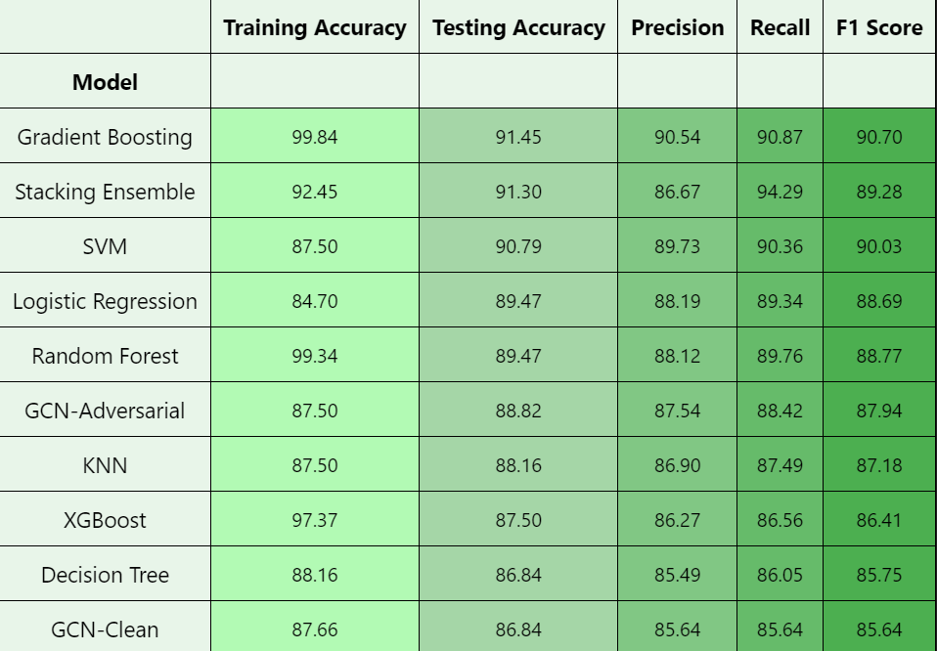
Model Comparison

Slide 13
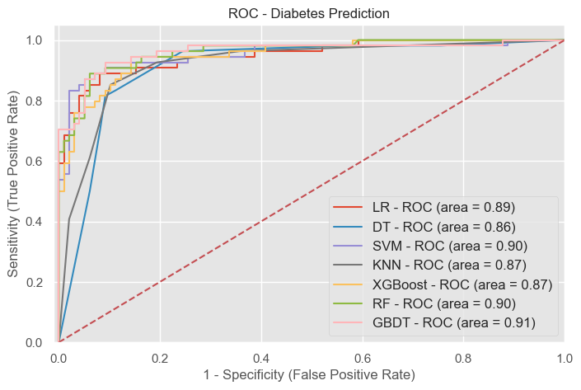
Model Comparison

Slide 14
Thank You

